Slide 1
Python

Slide 2
Array
Arrays can store multiple items of the same data type efficiently.
Unlike lists, which can store different types, arrays are type-specific.
Arrays are useful when you need performance and memory efficiency for large datasets.

Slide 3
Arrays vs Lists
Feature | List | Array (from array module)
Data types | Can hold any type | Must hold same type
Memory efficient | Less efficient | More efficient for large data
Built-in methods | Many | Fewer methods
Use cases | General purpose | Numeric data, fixed-type data

Slide 4
Using the array Module
Python has an array module o create arrays .
Import the module:
  import array
Create an array:
  arr = array.array(typecode, [initializer_list])

Slide 5
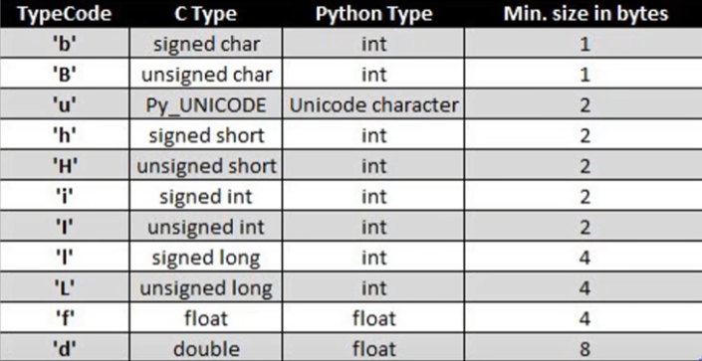
Typecode

Slide 6
Examples
Create an integer array and print it:
import array
arr = array.array('i', [10, 20, 30, 40, 50])
print(arr) # Output: array('i', [10, 20, 30, 40, 50])
print(arr[2]) # Access index 2: Output 30

Slide 7
Array Methods
Method | Description | Example Code | Output/Effect
append(x) | Add element x at the end | arr.append(60) | Adds 60 at end
insert(i, x) | Insert element x at index i | arr.insert(2, 25) | Inserts 25 at index 2
remove(x) | Remove first occurrence of element x | arr.remove(25) | Removes first 25
pop([i]) | Remove and return element at index i (default last) | last = arr.pop() | Removes and returns last element
index(x) | Return first index of element x | idx = arr.index(30) | Returns index of first 30
count(x) | Return count of occurrences of element x | cnt = arr.count(20) | Returns how many times 20 appears
extend(iterable) | Append items from iterable (list, array, etc.) | arr.extend([70, 80]) | Adds 70 and 80 at end
Notes:
import array
arr = array.array('i', [10, 20, 30])
arr.append(40)
arr.insert(1, 15)
print(arr) # array('i', [10, 15, 20, 30, 40])
arr.remove(20)
print(arr) # array('i', [10, 15, 30, 40])
print(arr.pop()) # 40
print(arr.index(30)) # 2
print(arr.count(15)) # 1
arr.extend([50, 60])
print(arr.tolist()) # [10, 15, 30, 50, 60]

Slide 8
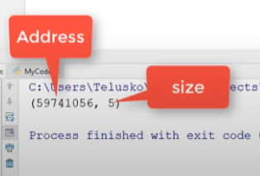
Array Methods
Method | Description | Example Code | Output/Effect
buffer_info() | Returns tuple (memory address, length) | info = arr.buffer_info() | Returns memory info tuple
typecode | Read-only attribute; type of elements stored | print(arr.typecode) | e.g. 'i' for integer
reverse() | Reverse array elements in place | arr.reverse() | Reverses array
tolist() | Convert array to Python list | lst = arr.tolist() | Returns a list
fromlist(list) | Append items from a Python list | arr.fromlist([90, 100]) | Adds 90, 100 at end
frombytes(bytes) | Append items from a bytes object | — | For binary data input
tobytes() | Convert array to bytes | b = arr.tobytes() | Returns bytes representation
Notes:
import array
# Initial array
arr = array.array('i', [10, 20, 30, 40, 50])
print("Original array:", arr)
# append(x)
arr.append(60)
print("After append(60):", arr)
# insert(i, x)
arr.insert(2, 25)
print("After insert(2, 25):", arr)
# extend(iterable)
arr.extend([70, 80])
print("After extend([70, 80]):", arr)
# remove(x)
arr.remove(30)
print("After remove(30):", arr)
# pop([i])
removed_value = arr.pop(3)
print("Popped value:", removed_value)
print("After pop(3):", arr)
# index(x)
pos = arr.index(40)
print("Index of 40:", pos)
# reverse()
arr.reverse()
print("After reverse():", arr)
# buffer_info()
print("Buffer info:", arr.buffer_info())
# count(x)
print("Count of 20:", arr.count(20))
# tolist()
list_version = arr.tolist()
print("Converted to list:", list_version)
# fromlist()
arr.fromlist([90, 100])
print("After fromlist([90, 100]):", arr)
# tobytes()
bytes_data = arr.tobytes()
print("Array to bytes:", bytes_data)
# frombytes()
# Create new array and load bytes_data into it
arr2 = array.array('i')
arr2.frombytes(bytes_data)
print("New array from bytes:", arr2)

Slide 9
Practical
Create an integer array with 5 elements of your choice and print it
Write a program that takes an array of integers and calculates the sum of all elements.
Write a function that finds and returns the maximum value in an integer array.
Given an array, count how many times a certain value appears.
Write a program to reverse the elements of an array without using the built-in reserves() method.
Take two arrays from the user and merge them into one array.
Take a Python list from the user, convert it to an array, then convert it back to a list and print both.
Find the index of a certain value in an array and replace it with another value.

Slide 10
?

